Slide 1
Advanced CSS
Mr. Mack 2022

Slide 2
Introduction
CSS3 offers a whole lot of interesting functionality that you didn’t know about but will really help you make your sites into something special. Just be conscious of browser compatibility issues – some of these aren’t available on older browsers.

Slide 3
Learning Outcomes
How do you round corners of a box?
How do you add a shadow to a box?
How do you rotate an element a specified amount?
What interesting animations can you use in CSS3?
What are pseudo-elements and what are they useful for?

Slide 4
Read this!
Read about CSS Transitions, stop at the Javascript section.
Notes:
🍐 This is a Pear Deck Web Slide.
🍐 To edit the type of question, go back to the "Ask Students a Question" in the Pear Deck sidebar.

Slide 5
Peruse
Peruse through these CSS Animated Loading Icons for some animation inspiration.
Notes:
🍐 This is a Pear Deck Web Slide.
🍐 To edit the type of question, go back to the "Ask Students a Question" in the Pear Deck sidebar.

Slide 6
Glance
Glance at canIuse, a compatibility table for various elements in CSS and HTML5.
Notes:
🍐 This is a Pear Deck Web Slide.
🍐 To edit the type of question, go back to the "Ask Students a Question" in the Pear Deck sidebar.

Slide 7
Knowledge Check

Slide 8
How do you round corners of a box?
Notes:
🍐 This is a Pear Deck Text Slide
🍐 To edit the type of question, go back to the "Ask Students a Question" in the Pear Deck sidebar.

Slide 9
How do you rotate an element a specified amount?
Notes:
🍐 This is a Pear Deck Text Slide
🍐 To edit the type of question, go back to the "Ask Students a Question" in the Pear Deck sidebar.

Slide 10
What are pseudo-elements and what are they useful for?
Notes:
🍐 This is a Pear Deck Text Slide
🍐 To edit the type of question, go back to the "Ask Students a Question" in the Pear Deck sidebar.

Slide 11
Resources
W3Schools on Border Radius
W3Schools on Box Shadow
W3Schools on Transforms
Using ::before and ::after Pseudo-Elements and a bunch of cool things they can be used for
MDN Web Docs on Animation

Slide 12
transforms

Slide 13
Introduction
The transform property is a powerful tool to change the appearance of elements without affecting the natural document flow.
You have likely seen it in action on many of your favorite websites! Transforms are very commonly used for animated effects. While we are sure you’ll like to create sleek animations of your own, we first need to understand how transforms work.

Slide 14
Learning Outcomes
How to use 2D transforms.
How to use 3D transforms.
How to chain multiple transforms.
The benefits of using the transform property.

Slide 15
Basics of Transform
The transform property takes in one or more CSS transform functions as its values, with those functions taking in their own value, usually an angle or a number.
Almost all elements can have the transform property applied to it, with the exceptions being <col>, <colgroup>, and non-replaced inline elements. “Non-replaced” simply refers to elements whose content is contained within the HTML document (<span>, <b>, and <em>, for example), as opposed to a “replaced” element’s content being contained outside of the document (<a>, <iframe>, and <img>, for example). You do not need to memorize every element that is non-replaced, but rather keep this knowledge in mind should you try to apply the transform property to an element and aren’t sure why it isn’t working.

Slide 16
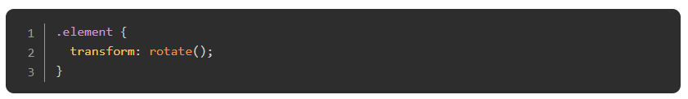
2D Transforms
n this section, we’ll go through 2D transforms with the following transform functions: rotate, scale, skew, and translate.
Rotate
This is the transform function value to rotate an element on a 2D plane:
Notes:
🍐 This is a Pear Deck Web Slide.
🍐 To edit the type of question, go back to the "Ask Students a Question" in the Pear Deck sidebar.

Slide 17
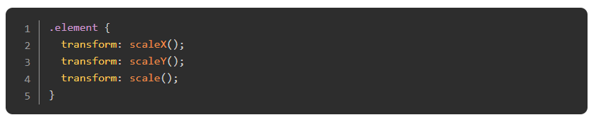
Scale
These are the transform function values to scale an element on a 2D plane:
Notes:
🍐 This is a Pear Deck Web Slide.
🍐 To edit the type of question, go back to the "Ask Students a Question" in the Pear Deck sidebar.

Slide 18
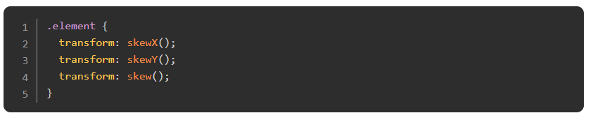
Skew
These are the transform function values to skew an element on a 2D plane:
Notes:
🍐 This is a Pear Deck Web Slide.
🍐 To edit the type of question, go back to the "Ask Students a Question" in the Pear Deck sidebar.

Slide 19
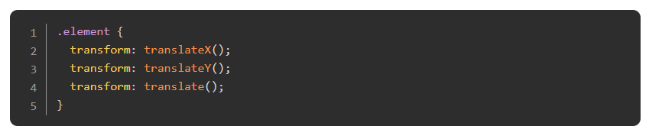
Translate
These are the transform function values to translate an element on a 2D plane:
Notes:
🍐 This is a Pear Deck Web Slide.
🍐 To edit the type of question, go back to the "Ask Students a Question" in the Pear Deck sidebar.

Slide 20
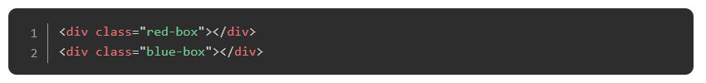
Chaining Multiple Transforms
Now that you have a grasp of 2D transforms, we will learn how to chain them. Chaining multiple transforms is as simple as adding more transform functions with a space between each one. Take a look at the code below:

Slide 21
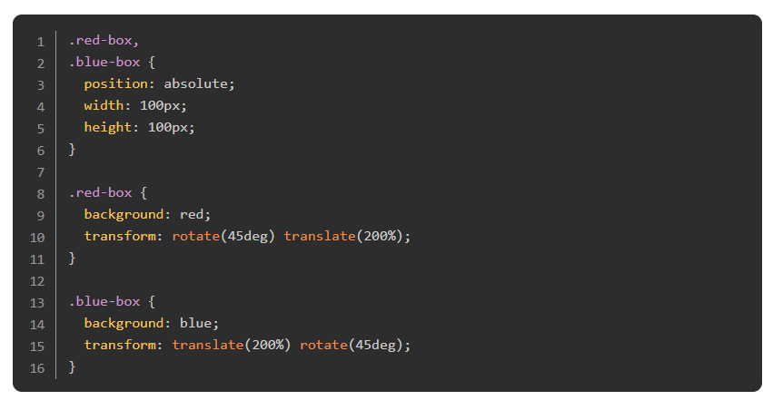
Chaining Multiple Transforms
Notes:
🍐 This is a Pear Deck Web Slide.
🍐 To edit the type of question, go back to the "Ask Students a Question" in the Pear Deck sidebar.
There are two boxes located at the same position. We chained rotate and translate function values to both boxes, but in different orders. Make a guess on what happens to each box, then click the “Result” link in the Codepen below to see if you were right. If you guessed correctly, congratulations! Otherwise, you’ve now learned that when chaining multiple transforms, each transform function is applied from right to left.
While you can generally chain multiple transforms in any order for various results, there is one exception: perspective. This brings us nicely to the next section where perspective is involved.

Slide 22
3D Transforms
The rotate, scale, and translate transform functions aren’t limited to just the 2D plane. They work for the 3D plane as well! However, to perceive a 3D effect on some of these function values, perspective is required.
From here on, the examples get more complicated, so there will be more links to external resources which do an excellent job describing how each property works. Play around with these properties until you feel comfortable with them, but be careful not to get too sidetracked with them.

Slide 23
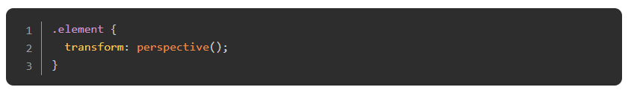
Perspective
This is the transform function value to set the distance from the user to the z = 0 plane:
Notes:
🍐 This is a Pear Deck Web Slide.
🍐 To edit the type of question, go back to the "Ask Students a Question" in the Pear Deck sidebar.
Essentially, by setting a perspective value, we are telling the object to render as if we were viewing it from a specific distance on the z-axis.
Unlike other transform function values, perspective must be declared first (leftmost) when there are multiple transform function values. In the upcoming examples for rotate, scale, and translate, we will be able to see how it affects the target element

Slide 24
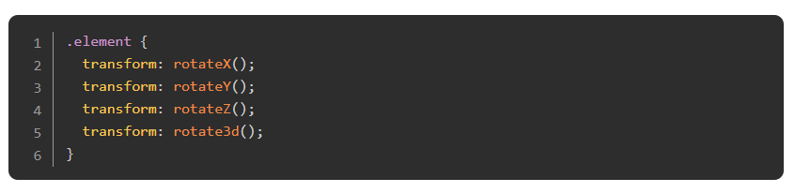
Rotate
These are the additional transform function values to rotate an element on a 3D plane:
Notes:
🍐 This is a Pear Deck Web Slide.
🍐 To edit the type of question, go back to the "Ask Students a Question" in the Pear Deck sidebar.
To learn about how rotate3d works, check out this great demonstration on MDN and this one on Quackit.

Slide 25
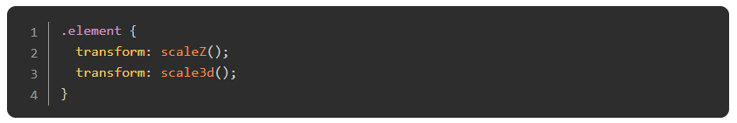
Scale
These are the additional transform function values to scale an element on a 3D plane:
Notes:
See MDN’s 3D cube in action with scaleZ here and scale3d here.

Slide 26
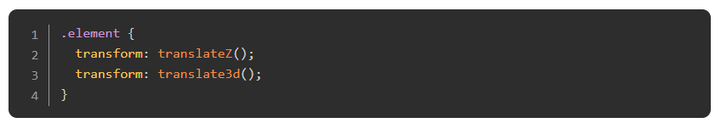
Translate
These are the additional transform function values to translate an element on a 3D plane:
Notes:
🍐 This is a Pear Deck Web Slide.
🍐 To edit the type of question, go back to the "Ask Students a Question" in the Pear Deck sidebar.
translateZ doesn’t do much without perspective. Instead, perspective and translateZ work together to create the illusion of 3-dimensional distance from the rendered object, as shown in the example below.
For a great demonstration on translate3d checkout the the MDN cube again!

Slide 27
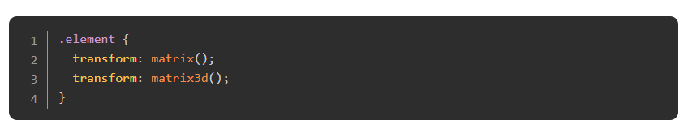
Matrix
While not strictly a 3D transform function, matrix is mentioned last in this lesson due to how uncommonly used it is. These are the transform function values for it.
Notes:
Matrix is a way of combining all transform functions into one. It is seldom used due to its poor readability, and almost never written by hand. Unless you have a very complex transformation to apply, you should use other transform function values instead.
It is enough for you to know that these functions exist and generally how they work. However, it is not important for you to feel comfortable building with them. Skim this article to get the gist of matrix

Slide 28
Benefits of Transform
In order to understand why the transform property is great, you have to be aware of CSS triggers. You can learn about about it in The Pixel Pipeline section from Google’s Web Fundamentals.
The key benefit of using transform is that it occurs during composition. This makes it cheaper to use compared to many other CSS properties. You can see a table of what triggers are executed with each CSS property here.
Another benefit of transform is that it can be hardware-accelerated via a device’s GPU (you don’t have to understand how a GPU works but it is good to be aware of the term and what it means). This benefit is more prominent when it comes to transitions and animations which you will learn about in the following lessons.

Slide 29
Knowledge Check

Slide 30
What are the four main functions of the transform property?
Notes:
🍐 This is a Pear Deck Text Slide
🍐 To edit the type of question, go back to the "Ask Students a Question" in the Pear Deck sidebar.

Slide 31
Which function can be used to make an object larger or smaller on the X, Y, or Z axis?
Notes:
🍐 This is a Pear Deck Text Slide
🍐 To edit the type of question, go back to the "Ask Students a Question" in the Pear Deck sidebar.

Slide 32
What additional function is required for 3D transforms?
Notes:
🍐 This is a Pear Deck Text Slide
🍐 To edit the type of question, go back to the "Ask Students a Question" in the Pear Deck sidebar.

Slide 33
Resources
Here’s a good resource that summarizes most common transform functions with some additional insight to how you may use them.
For a full reference, there’s always MDN.
For more on the 3D transform functions, W3Schools has a good article demonstrating how they work.

Slide 34
Transitions

Slide 35
Introduction
It’s time to dive into the exciting world of CSS transitions and give your HTML elements some slick transformations!

Slide 36
Learning Outcomes
What a CSS transition is and when to use it
Know what CSS properties are animatable and which ones are not
How to make sure your transitions are smooth and performant

Slide 37
Transitions
CSS transitions let you animate a change from an element’s initial state to an end state. Think of an ordinary button element with a white background. When your mouse is away from the button, it’s just sitting there. Boring. Then when you hover your mouse cursor over the button the background color smoothly transitions from white to grey to black over a period of time. This is a CSS transition. Have a look at the Codepen below to see one in action.
Notes:
🍐 This is a Pear Deck Web Slide.
🍐 To edit the type of question, go back to the "Ask Students a Question" in the Pear Deck sidebar.

Slide 38
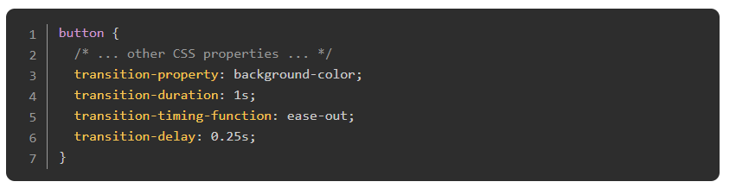
Transitions
When your mouse cursor is away from the button, the button is in the initial state. When you hover over it you introduce the end state, the hover state, causing the transition of the color smoothly fading from white to black to occur.
This was achieved using the transition property, which is actually a shorthand property for transition-property, transition-duration, transition-timing-function and transition-delay.

Slide 39
Transitions
transition-property - This determines what CSS property will be transitioned. In this case it is the background-color.
transition-duration - This determines the duration that the transition will occur over. In this case the color change will gradually happen over 1 second.
transition-timing-function - This lets us change the speed of the transition over the course of its duration. Here it will ease-out, meaning the color change will be faster at the start than at the end of the transition.
transition-delay - This determines the delay at which the transition will start. In this case, the color change starts a quarter of a second after the cursor rests on the button.

Slide 40
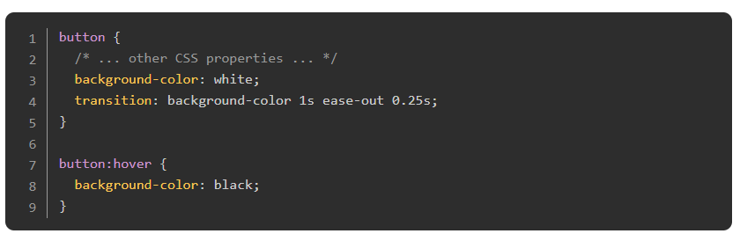
Transitions
The shorthand property looks like this:
Notes:
The above transition will occur when the user hovers their mouse over the button as indicated by the :hover pseudo-class. In addition to :hover, or any of the other pseudo-classes, you can also trigger transitions by adding or removing classes with JavaScript. For example, clicking a button could append the “open” class to a dropdown menu, which would trigger the opening transition.

Slide 41
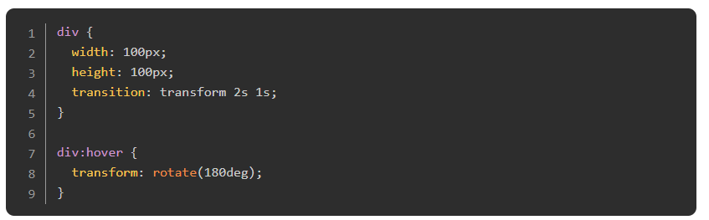
Performance
Generally, keeping your CSS transitions performant will not be an issue. However there are a couple of things you need to keep in mind.
The first is the “stacking context”. Basically, a stacking context is formed when certain element scenarios are in place. A relevant scenario for us would be to transition a transform property like below:

Slide 42
Performance
This has created a stacking context. If we were to make a bunch more stacking contexts through various other means then, when it comes to rendering our initial transform, we would repaint not only our div element but also every element that is stacked on top of it in the stack context. If left unchecked, this can cause your once buttery-smooth transition to become slow and rough.
The second thing to keep in mind is that you should keep your animations to only affecting opacity and transform if you want absolute best performance for animations on your web page. Yes, our first example above only carried out a simple background-color change, but even that was an expensive operation in itself.
What’s important is that you have a solid understanding of these concepts and can apply them when necessary because hey, if you need to turn a button into a rainbow when it’s hovered over, you better be able to transition that rainbow!

Slide 43
Read
Read the MDN article for using CSS transitions, including the links in the Defining transitions section of the article. Make sure you code along with any examples to become familiar with the syntax.

Slide 44
Another read
Read the MDN article about the stacking context for a deeper understanding.
Notes:
🍐 This is a Pear Deck Web Slide.
🍐 To edit the type of question, go back to the "Ask Students a Question" in the Pear Deck sidebar.

Slide 45
Learn
Learn some handy hints on how to create performant CSS animations by reading this article and check out the link it provides to CSS Triggers to see how an animatable CSS property may affect others. Look at the difference between the background-color and transform properties, for example.

Slide 46
Knowledge Check

Slide 47
Are all CSS properties animatable?
Notes:
🍐 This is a Pear Deck Text Slide
🍐 To edit the type of question, go back to the "Ask Students a Question" in the Pear Deck sidebar.

Slide 48
What are the long and short-hand notations for transitions?
Notes:
🍐 This is a Pear Deck Text Slide
🍐 To edit the type of question, go back to the "Ask Students a Question" in the Pear Deck sidebar.

Slide 49
Why do you need to keep an eye on repaints?
Notes:
🍐 This is a Pear Deck Text Slide
🍐 To edit the type of question, go back to the "Ask Students a Question" in the Pear Deck sidebar.

Slide 50
Resources
You can learn how to catch and debug repaint issues with this great article from Dzhavat Ushev.
You can play around with the CSS Cubic Bezier Generator to not only view how the cubic-bezier value works in an editable demo, but also to compare the different transition-timing-function values side by side.

Slide 51
KeyFrames

Slide 52
Introduction
Now let’s explore CSS animations using keyframes. This will expand upon your encounter with CSS transitions and delve into the differences between them.

Slide 53
Learning Outcomes
The differences between CSS transitions and CSS animations
How to configure animation sub-properties
How to sequence an animation using keyframes

Slide 54
Animations vs Transitions
Animations let you animate elements from one style configuration to another. Does this sound familiar? You wouldn’t be wrong for thinking, “Well, what’s the point in learning animations if they are basically the same as transitions?”, but animations greatly expand on some capabilities that transitions simply do not have. A few of the differences include:

Slide 55
Animations vs Transitions
Transitions were designed to animate an element from one state to another. They can loop, but they weren’t designed for that. Animations, on the other hand, were designed with the purpose of explicitly enabling loops.
Transitions need a trigger, such as the use of pseudo-classes like :hover or :focus, or by adding/removing a class via JavaScript. Animations, on the other hand, do not need such a trigger. Once you have your elements in place and CSS defined, an animation will start running immediately if that’s what you told it to do.
Transitions are not as flexible as using animations. When you define a transition, imagine you are sending that element on a journey in a straight line from point A to point B. Yes, the transition-timing-function can add some variation to the timing of this change, but it doesn’t compare to the amount of flexibility added by using animations.

Slide 56
Animations vs Transitions
All in all, both animations and transitions have their use, so in addition to considering the above differences you should also use your best judgement. For example, if you need to change the opacity of an element when it is active then an animation would be overkill, but if you need to carry out something more complicated, animations will provide you with the tools you need.

Slide 57
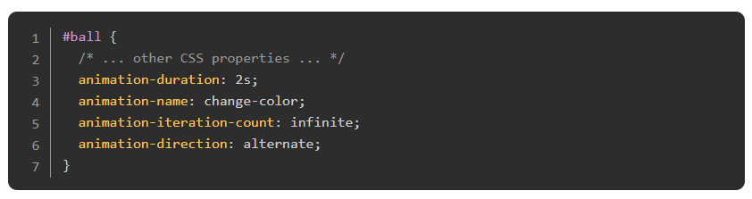
Animation Properties
Let’s see an animation in action to see what we’ve been talking about.
Note how the animation is already running and how it keeps repeating itself. We’ll cover that @keyframes rule at the bottom of our example in a bit, so for now focus on the actual animation properties used in the example above:
Notes:
🍐 This is a Pear Deck Web Slide.
🍐 To edit the type of question, go back to the "Ask Students a Question" in the Pear Deck sidebar.

Slide 58
Animation Properties
This is known as the configuration stage where we define our animation properties on the #ball element, and it is only the first half of defining an animation. In our example we have:
An animation-duration of two seconds. This means that it will take two seconds for the #ball element to complete one animation cycle.
Defined the animation-name to be “change-color” which is essential for the @keyframes section coming up next. This is just a custom name that is not a particular CSS value. We could have called it “pineapples” if we so wished, but for our purposes “change-color” suits well.
Set the animation-iteration-count to infinite, which means this animation will run forever. You could set this to 1, 2, or as many iterations as you wish.
Set the animation-direction to alternate. This property decides if our animation should alternate direction on the completion of one cycle, or reset to the start point and repeat itself. Here it means that the #ball will smoothly change back to it’s original color instead of “jumping” straight back to red.

Slide 59
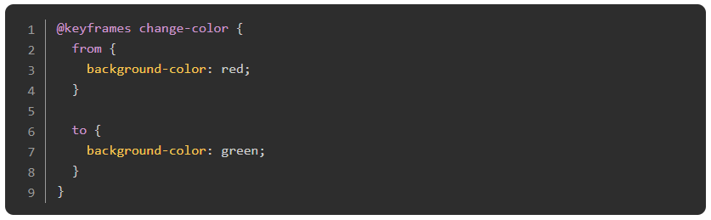
Keyframes
Now it’s time to tackle the second half of our animation definition by exploring the @keyframes at-rule.

Slide 60
Keyframes
The @keyframes at-rule references the ‘change-color’ name we defined earlier. Then, we use the from and to properties to change the background-color of #ball from red to green.
It’s important to know that keyframes use a percentage to indicate the times for an animation to take place and that the from and to statements are actually aliases for 0% and 100%, respectively. You can read from/0% as meaning ‘at zero seconds’ and to/100% as ‘at 2 seconds’ according to our animation-duration in our example from above. There is no hard and fast rule on whether or not you should use from/to or 0%/100%. Just pick a style and be consistent with it.

Slide 61
Keyframes
The @keyframes at-rule also defines one animation cycle. So if we were to change our animation-iteration-count from earlier to 2 then the ball would change its background-color from red to green, then from green to red, and then the animation would stop. Be careful not to think of one iteration as a complete loop, but rather a single cycle from beginning to end (or end to beginning when alternating the direction).
Now it’s time to introduce the shorthand notation for our animation properties and glimpse a little into the added flexibility of the keyframe notation. Check out the live example below then have a look at the notation.
Notes:
🍐 This is a Pear Deck Web Slide.
🍐 To edit the type of question, go back to the "Ask Students a Question" in the Pear Deck sidebar.

Slide 62
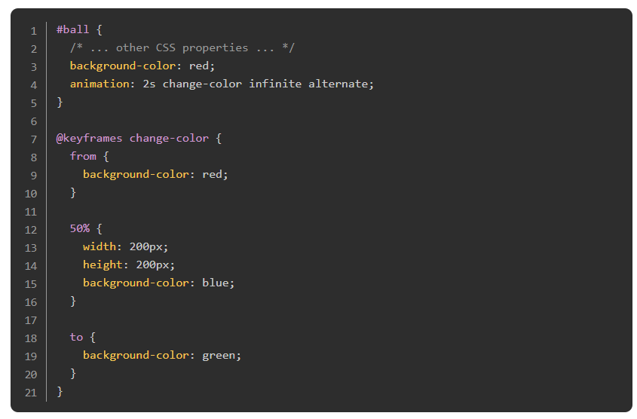
Keyframes

Slide 63
Keyframes
Here we added another keyframe for when the animation-duration is at 50%, or 1 second. This means as well as the background-color changing to an additional value, we have also specified that the ball double in size. Just be aware that additional keyframes are always defined in percentages. Only the 0%/100% values may use the from/to alias.
Hopefully this gives you a glimpse into the power the @keyframes syntax provides to you when it comes to controlling the animation of an element’s properties. You can add keyframes whenever you want, control whatever CSS-animatable properties you want, and have the control to add some real creative flair to your website elements.

Slide 64
Code
Code along with the the MDN article for using CSS animations.
Notes:
🍐 This is a Pear Deck Web Slide.
🍐 To edit the type of question, go back to the "Ask Students a Question" in the Pear Deck sidebar.

Slide 65
Read
Read the @keyframes reference to gain a deeper understanding of how keyframes are implemented.

Slide 66
Practice
Now let’s make some cool animations! Go to the CSS exercises repository and do the exercises in the ‘animation’ folder in this order:
button-hover
drop-down
pop-up
button-hover
drop-down
pop-up

Slide 67
Knowledge Check

Slide 68
What are the long and short-hand notations for CSS animations?
Notes:
🍐 This is a Pear Deck Text Slide
🍐 To edit the type of question, go back to the "Ask Students a Question" in the Pear Deck sidebar.

Slide 69
When would you use an animation over a transition (and vice versa)?
Notes:
🍐 This is a Pear Deck Text Slide
🍐 To edit the type of question, go back to the "Ask Students a Question" in the Pear Deck sidebar.

Slide 70
How do you add keyframes to an animation?
Notes:
🍐 This is a Pear Deck Text Slide
🍐 To edit the type of question, go back to the "Ask Students a Question" in the Pear Deck sidebar.

